Slide 1
ANDROID + SQLite

Slide 2
SQLite
Steps to create DB application
Create an object of the SQLite DB
Create table
SQLiteDatabase db = this.openOrCreateDatabase("myDB", MODE_PRIVATE, null);
db.execSQL("CREATE TABLE IF NOT EXISTS data(name VARCHAR, age INT(3));");

Slide 3
SQLite Example Application
1. Add User Class
2. Add UserAdapter Class
3. Make necessary changes to activity_main
4. Add data_items.xml

Slide 4
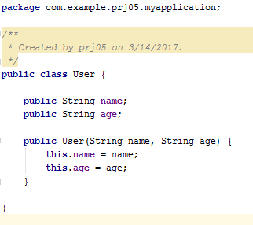
User.java

Slide 5
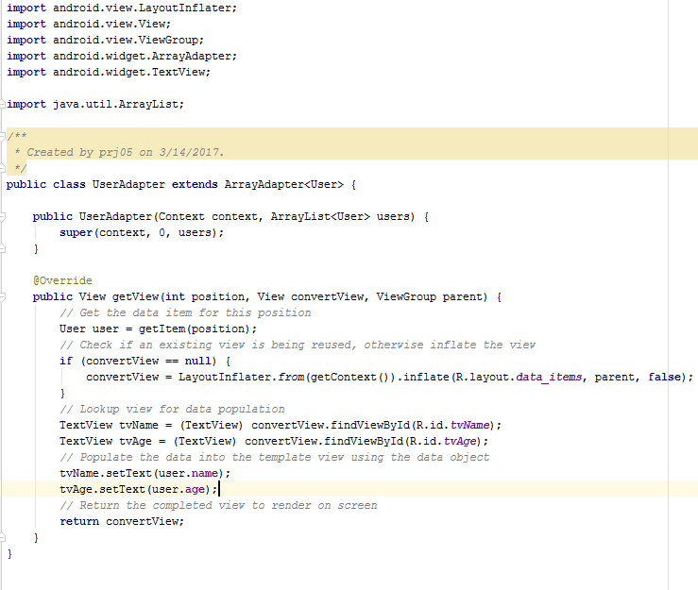
UserAdapter.java

Slide 6
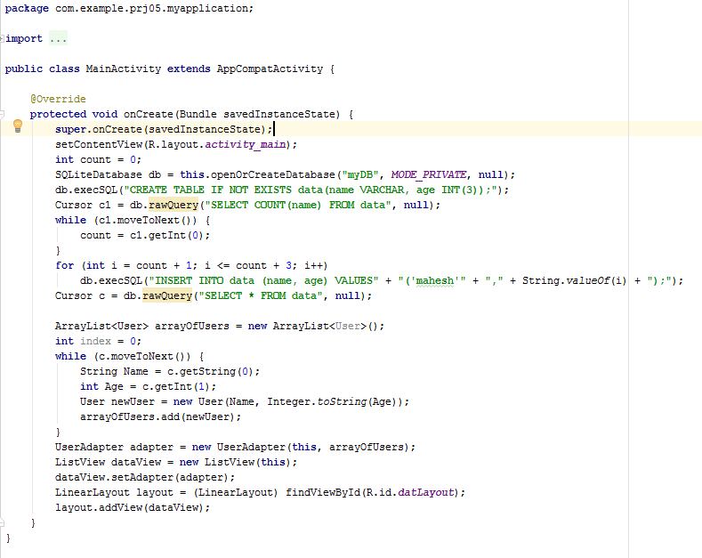
MainActivity.java

Slide 7
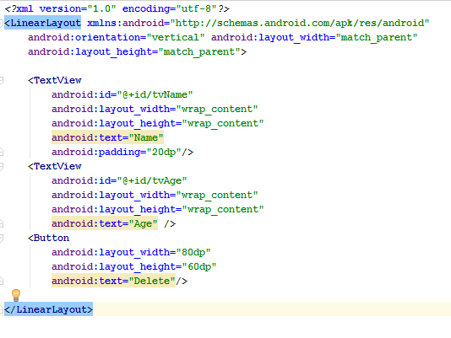
Data_items.xml

Slide 8
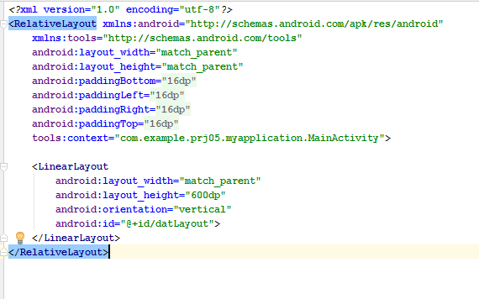
Activity_main.xml

